Slide 1
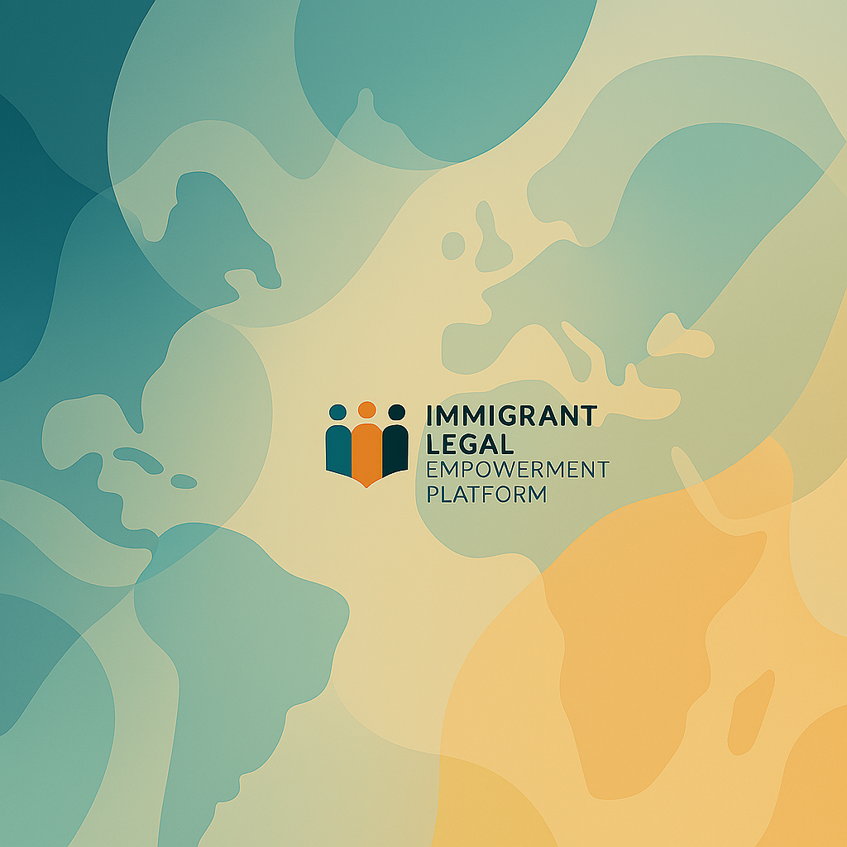

Slide 2
Introduction
ILEP is the initial part of a project that aims to empower immigrants through legal education, and legal access.

Slide 3

Background
Immigrant communities in the United States face significant structural barriers in:
accessing legal information
navigating complex immigration and labor regulation
stablishing lawful economic participation.
Limited access to legal assistance due to:
language,
geography,
cost, and institutional trust
Leading to increased vulnerability to:
exploitation,
loss of immigrant status,
economic instability.

Slide 4
Proposed Solution
The initiative introduces a Strategic Legal Empowerment Framework composed of four interlinked components:
  Immigrant Legal Empowerment Platform (ILEP)
  Community Legal Navigation Program (facilitators)
  Workforce Justice & Entrepreneurship Hub (employment/ labor law)
  Policy Intelligence & Reform Catalyst (local data for partner institutions)
  Component 1 is the base and the component 2-4 will be implemented after 1 is fully operational.

Slide 5
Expected Results
  Preventive basic legal education for 100,000 immigrants over five years.
  Deployment navigators facilitators for workshops (150 after step 2 in 3 years)
  Enhanced Small business registrations in areas impacted by partners institutions. (Goal over 2000 after step 3)
  Enhanced information database for partners institutions/influence policy change.

Slide 6
Who is doing?
Alexandre G. Carvalho
  Attorney in Brazil and US (NY), Master in American Legal System (Syracuse-NY)
  Background with –
    Employment law – theft wage/ class actions in NYC
    Immigration – removal/deportation defense / family immigration
    Legal education (professor for MBA at MIU) – business law, employment law, mediation, and entrepreneurship courses

Slide 7
Step 1 – Legal education
Course development Platform and pilot launch with partner institutions targeting 1,000 users
Review of the pilot / adjustments and fixes
Initial platform, for quick launch will use Open source free LMS for evaluation of the initiative and asynchronous Online course.

Slide 8
Course
Delivery – asyncrhonous (adaptable) – 12 weeks maximum (1 hours per week) self-paced or in institutions
Target audience - Immigrants in the US, undocumented or documented, suffer from a lack of education regarding their rights and duties as immigrants, usually low income, and low level of formal education.
Overview
Focusing on rights, responsibilities, and actionable strategies
related to: employment, entrepreneurship, and immigration, human rights.
Designed to bridge systemic gaps in legal literacy,
Course combines short video lectures, downloadable guides, scenario-based assessments, and multilingual content
(English, Spanish, and Portuguese initially).

Slide 9
Course objectives
The goal of the course is that, after each module, the student will be able to identify simple issues and understand how to find
reliable help or
apply for redress for their issues.
Delivery
Quick videos / audios / text (with text-to-speech) and webinar for Q&A
Notes:
Common problems :
Wage theft / torts-contracts rights

Slide 10
Access
This platform will be free for partners institutions – Those who support this project by a letter of support to be used for expansion-bring new institutions.
The institution will give free access to every person they give support by giving a code to access the platform.
By the code it will be possible to tweak the course according to the needs of the local public. (filter subjects/language terms to local regulations, etc.)
Notes:
Common problems :
Wage theft / torts-contracts rights

Slide 11
Some key points
From my experience in teaching-attendance expects:
  Legal advice/ Identify risks in redress (can I be deported if I sue?).
  COLLATERAL RESULT OF THE PROJECT
  References (attorneys, advocates)
  Empowerment through education – righs in employment, immigration, civil rights, business
Notes:
Common problems :
Wage theft / torts-contracts rights

Slide 12
NEXT STEPS
After Educational platform is ready, the other phases will start.
Local workshosp, Facilitators for “legal deserts”
Intake forms/direction to partners and community association, non-profit that give legal and social assistance to immigrants and Data for policy change to partners that are key influencers.
Notes:
Common problems :
Wage theft / torts-contracts rights

Slide 13
Thanks for your Attention and support in this project
Notes:
Common problems :
Wage theft / torts-contracts rights

